Slide 1

McLAB: Compiler Tools for MATLAB
Amina Aslam
Toheed Aslam
Andrew Casey
Maxime Chevalier- Boisvert
Jesse Doherty
Anton Dubrau
Rahul Garg
Maja Frydrychowicz
Nurudeen Lameed
Jun Li
Soroush Radpour
Olivier Savary
Laurie Hendren
McGill University
Leverhulme Visiting Professor
Department of Computer Science
University of Oxford
TexPoint fonts used in EMF.
Read the TexPoint manual before you delete this box.: AAAAAAAAA
Notes:
MATLAB is a popular dynamic programming language used for scientific and numerical programming. As a language, it has evolved from a small scripting language intended as an interactive interface to numerical libraries, to a very popular language supporting many language features and libraries. The overloaded syntax and dynamic nature of the language, plus the somewhat organic addition of language features over the years, makes static analysis of modern MATLAB quite challenging. In this talk I will motivate why it is important for programming language and compiler researchers to work on MATLAB and I will provide a high-level overview of McLab, a suite of compiler tools my group is developing at McGill. The main technical focus of the talk will be on the foundational problem of resolving the meaning of an identifier in MATLAB. To solve this problem we have developed two analyses, a flow-insensitive "kind analysis" and a flow-sensitive "handle analysis". I will present the analyses, some experimental results and show how the results of the analysis are required for other compiler tools.

Slide 2

Overview
Why MATLAB?
Introduction to MATLAB – challenges
Overview of the McLab tools
Resolving names in MATLAB
Notes:
This talk starts with an exploration of why it is important for compiler/PL researchers to work on MATLAB and languages like MATLAB.
We then proceed to an introduction to the MATLAB language, and we illustrate some of the challenges of dealing with MATLAB.

Slide 3
Nature Article: “Why Scientific Computing does not compute” [Merali, Oct 2010]
38% of scientists spend at least 1/5th of their time programming.
Codes often buggy, sometimes leading to papers being retracted. Self-taught programmers.
Monster codes, poorly documented, poorly tested, and often used inappropriately.
45% say scientists spend more time programming than 5 years ago.
Notes:
October 2010 article in Nature, by Zeeya Merali. Survey of 2000 scientists.
It is important that compiler/PL researchers aim to provide programming languages and systems that both provide:
programming environments in which scientists can program easily
systems that lead to solid and extensible code.

Slide 4


FORTRAN
C/C++
Java
AspectJ
MATLAB
PERL
Python
Domain-specific
Notes:
Scientist in upper right ... Many different applications to program, which language to pick? Increasingly picking dynamic or scripting languages. Many scientific and engineering computations use MATLAB.
Computer Scientist, Compiler writer, lower left. Has worked on compilers and tools for object-oriented and aspect-oriented languages ... But scientists are not interested in these languages.

Slide 5
A lot of MATLAB programmers!
Started as an interface to standard FORTRAN libraries for use by students.... but now
1 million MATLAB programmers in 2004, number doubling every 1.5 to 2 years.
over 1200 MATLAB/Simulink books
used in many sciences and engineering disciplines
Even more “unofficial” MATLAB programmers including those using free systems such as Octave or SciLab.
Notes:
There are a lot of MATLAB users, shouldn't we be doing something for them?

Slide 6
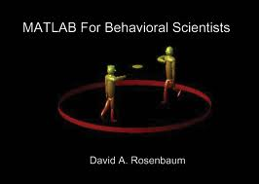


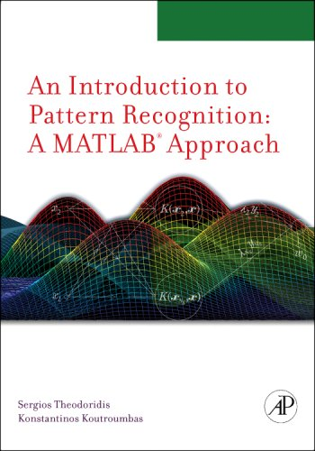


Notes:
Check out the number and variety of disciplines ….
Books are often "how to" in terms of using MATLAB. We also need some books that describe MATLAB in way that both uses solid PL terminology and foundations, but also talks about the domain-specific applications.

Slide 7
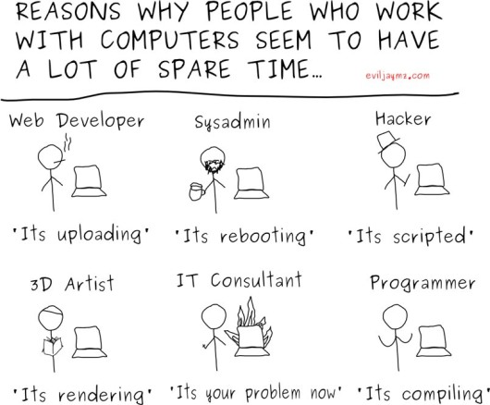
Why do Scientists choose MATLAB?
MATLAB
FORTRAN
Notes:
Why do scientists choose MATLAB?
Why not something like FORTRAN? - advantages are good compilers, efficient execution.
But programmers are choosing MATAB – faster prototyping – no types, lots of toolboxes, interactive development style...

Slide 8
Implications of choosing a dynamic, “scripting” language like MATLAB….
Notes:
Although Scientists like the interactive and "wild west" development style of MATLAB, what are the implications of choosing a dynamic "scripting" language like MATLAB?

Slide 9

Many run-time decisions …
Potentially large runtime overhead in
both time and
space
Notes:
Original implementation by MATHWORKs interpreted, their system now contains a JIT (which they call an "accelerater"). Open implementations like Octave and Scilab are interepreted.

Slide 10
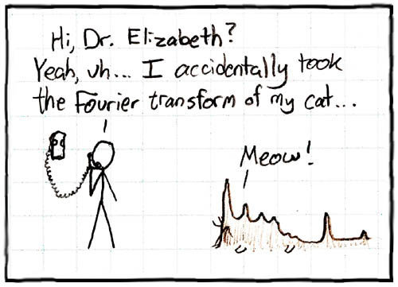
No types and “flexible” syntax
http://imgs.xkcd.com/comics/fourier.jpg
Notes:
MATLAB often computes something, even if it was not was intended.

Slide 11

Most semantic (syntactic) checks made at runtime … No static guarantees
Notes:
MATLAB programmers get very few static guarantees, but quite often program in some dynamic checks.

Slide 12
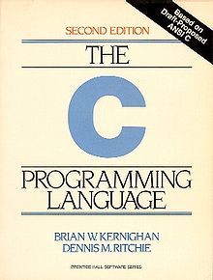
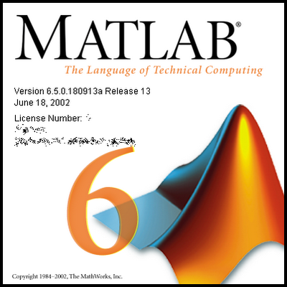
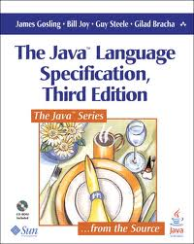
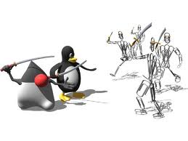

No formal standards for MATLAB
Notes:
Lack of a standard – the semantics can change in a new release from Mathworks.
If the research community can help distill out a proper specification, it will enhance research opportunities and perhaps encourage some standardization.

Slide 13
Culture Gap
Scientists / Engineers
Programming Language / Compiler Researchers
Comfortable with informal descriptions and “how to” documentation.
Don’t really care about types and scoping mechanisms, at least when developing small prototypes.
Appreciate libraries, convenient syntax, simple tool support, and interactive development tools.
Prefer more formal language specifications.
Prefer well-defined types (even if dynamic) and well-defined scoping and modularization mechanisms.
Appreciate “harder/deeper/more beautiful” programming language/compiler research problems.
Notes:
PL and compiler researchers need to consider the scientific community and their perspective.
What can we do to enhance their programming experience, while still doing interesting research from a CS perspective?
Does the PL/compiler community need to broaden their perspective of what is useful/good research?

Slide 14
Goals of the McLab Project
Improve the understanding and documentation of the semantics of MATLAB.
Provide front-end compiler tools suitable for MATLAB and language extensions of MATLAB.
Provide a flow-analysis framework and a suite of analyses suitable for a wide range of compiler/soft. eng. applications.
Provide back-ends that enable experimentation with JIT and ahead-of-time compilation.
Enable PL, Compiler and SE Researchers to work on MATLAB
Notes:
Our goals are to provide an infrastructure that supports the research for MATLAB, and to do such research ourselves.

Slide 15
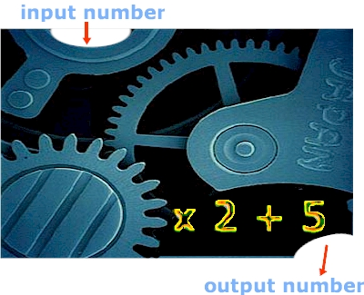
Brief Introduction to MATLAB
Functions and Scripts in MATLAB
Notes:
There are two main ways of defining MATLAB computations, through functions which have input and output parameters, and through scripts which have no parameters, and are effectively just a sequence of statements. Let's look at functions first.

Slide 16
Basic Structure of a MATLAB function
>> [a,b] = ProdSum([10,20,30],3)
a = 6000
b = 60
>> ProdSum([10,20,30],2)
ans = 200
>> ProdSum(‘abc’,3)
ans =941094
>> ProdSum([97 98 99],3)
ans = 941084
Notes:
On first click:
Here is an example of a function definition of a function called ProdSum. It has two input parameters, "a" and "n", and two output parameters, "prod" and "sum". There is also a local variable "i".
This function should be stored in a file called ProdSum.m. If it is stored in a file of another name, say "foo.m" then the function can only be called as foo(...).
Note that there are no type declarations and no explicit declarations of variables. "i" is a variable because it is defined (i.e. it is assigned to in the header of the for loop.
There are no return statements for returning the values of the output parameters, the values returned are simply the values those variables contain when the function returns.
On second click:
Here is an example of an interaction with the MATLAB read-eval-print loop. The user types in the statement after the ">>" prompt and the statement is evaluated and the result printed. If an explicit assignment is made in the statement, the values of the lhs are printed, otherwise the result of evaluating the expression is assigned to a variable called "ans" and its value is printed.
The first call calls ProdSum with a 1x3 array [10,20,30] as the first argument, and a 1x1 array 3 as the second argument. The first return value is assigned to "a" and the second to "b".
The second call does not give a lhs, so the first of the return values is assigned to ans and the 2nd return value is thrown away. A similar thing would happen if you explicity said "myans = ProdSum....".
The third call illusrates that ProdSum works on various types. In this case the first argument is an array of characters, which are effectively treated as an array of ASCII values. Thus the 4th statement computes the same value as the 3rd.

Slide 17
Primary, nested and sub-functions
Primary Function
Nested Function
Sub- Function
Notes:
Although MATLAB programmers tend to put only one function in a file, there are some mechanisms for collecting together related functions in the same file.
The first function is called the primary function, and this one should have the same name as the file. This is the only function which is visible outside of the file.
Subsequent functions, defined after the primary function are called sub-functions. Sub-functions are only visible to other functions in the same file.
Function definitions can also be nested, and these follow the expected scoping rules. The only non-obvious point is determining which function "declares" a local variable. Effectively it is the innermost function which contains a parameter or definition of that variable.

Slide 18
Basic Structure of a MATLAB script
>> clear
>> a = [10, 20, 30];
>> n = 3;
>> whos
Name Size Bytes Class
a 1x3 24 double
n 1x1 8 double
>> ProdSumScript()
>> whos
Name Size Bytes Class
a 1x3 24 double
i 1x1 8 double
n 1x1 8 double
prod 1x1 8 double
sum 1x1 8 double
Notes:
Now that we understand functions, let's look at something a little less structured, scripts ....
1st click: If a script is stored in a file foo.m, then it is called by "foo" or "foo()"
A script is neither a zero-argument function, nor a macro, but something in between.
Scripts use the workspace of their caller, which could be the read-eval-print loop, or the last-called function.
2nd click: let's look at an example of calling a script from the read-eval-print loop. First we have to ensure that the appropriate variables are defined (statements 1 through 3). Note that "whos" is a built-in function that displays the current workspace. We then call ProdSumScript, and then look in the workspace again, where we see that prod and sum have been defined.

Slide 19
Directory Structure and Path
Each directory can contain:
.m files (which can contain a script or functions)
a private/ directory
a package directory of the form +pkg/
a type-specialized directory of the form @int32/
At run-time:
current directory (implicit 1st element of path)
directory of last called function
path of directories
both the current directory and path can be changed at runtime (cd and setpath functions)
Notes:
MATLAB programmers tend to accumulate lots of functions in their current directory. However, there are mechanisms for grouping functions together.
First, you can put them in a /private directory. These functions will be visible to functions in the outer directory.
Second you can create directories starting with "+" which correspond to packages. Such functions must be called using pkg.f(). You can have sub-packages as well.
Third, you can have type-specialized directories, which start with "@". These will be called when the first argument matches the type of the directory name.
At run-time a function is looked up first in the current directory, and then if not found the directories along the path are searched. Note that both the current directory and the path can be changed at run-time.

Slide 20
Function/Script Lookup Order (call in the body of a function f )
function f
...
foo(a);
...
end
Nested function (in scope of f)
Sub-function (in same file as f)
Function in /private sub-directory of directory containing f.
1st matching function, based on function name and type of first argument, looking in type-specialized directories, looking first in current directory and then along path.
1st matching function/script, based on function name only, looking first in current directory and then along path.
Notes:
Let's look at the rules for looking up a function. They are as listed on the slide. Note that a nested, sub-function or private function takes precedence over a type-specialized function. Hence, if you want to make a function type-specialized it must be moved out a file or private directory.
In the example, for the call of foo, first look in the body of f, then in the file of f, then in the /private directory of the directory containing the file of f. If not found yet, then look along the path for a type-specialized foo that matches the run-time type of "a", and then if not found, look along the path for a function with name "foo".

Slide 21
Function/Script Lookup Order (call in the body of a script s)
% in s.m
...
foo(a);
...
Function in /private sub-directory of directory of last called function (not the /private sub-directory of the directory containing s).
1st matching function/script, based on function name, looking first in current directory and then along path.
dir1/ dir2/
f.m s.m
g.m h.m
private/ private/
foo.m foo.m
Notes:
Now, what about a looking up a call which is the body of a script? This is not equivalent to first macro-expanding the call. It is also different than the lookup call for functions.
If f.m is a function definition containing a call to foo, foo will be found in dir1/private/foo.m.
If s.m is a script definition containing a call to foo, foo will not necessarily be found in dir2/private/foo.m. Rather, it depends on the directory of the last function called. For example, if g.m called s, then foo will be dir1/private/foo.m. If h.m called s, then foo will be dir2/private/foo.m.

Slide 22
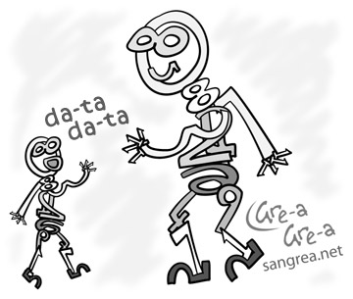
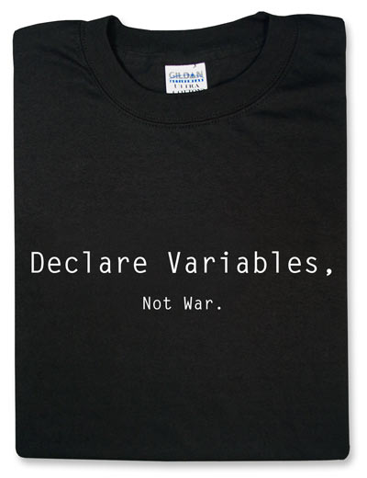
Variables and Data in MATLAB
Notes:
Ok, now we understand functions.... what about variables in MATLAB.
We already know they are not explicitly declared.

Slide 23
MATLAB types: high-level
Notes:
Now let's look at the high-level data types. A variable can be either data or a function handle. If it is data, then it could be an array, which is homogenous, a cellarray which is effectively an array of cells, where each cell can contain a different type, or it can be a struct with named fields.

Slide 24
Variables
Variables are not explicitly declared.
Local variables are allocated in the current workspace. Global and persistent variables in a special workspace.
All input and output parameters are local.
Local variables are allocated upon their first definition or via a load statement.
x = ...
x(i) = ...
load (’f.mat’, ’x’)
Local variables can hold data with different types at different places in a function/script.
Notes:
Variables are by default local. They are implicitly declared through assignments, or through load statements. Variables can hold different types at different places in the body of a function/script.

Slide 25
Variable Workspaces
There is a workspace for global and persistent variables.
There is a workspace associated with the read-eval-print loop.
Each function call creates a new workspace (stack frame).
A script uses the workspace of its caller (either a function workspace or the read-eval-print workspace).
Notes:
We can think of the environment as being a collection of workspace, one for globals and persistents, one for the read-eval-print-loop and one for each function call.

Slide 26
Variable Lookup
If the variable has been declared global or persistent in the function body, look it up in the global/persistent workspace.
Otherwise, lookup in the current workspace (either the read-eval-print workspace or the top-most function call workspace).
For nested functions, use the standard scoping mechanisms.
Notes:
How are variables looked up? If global/persistent, look in the global/persistent workspace, otherwise lookup in the current workspace. If not found, then may trigger a run-time error.

Slide 27
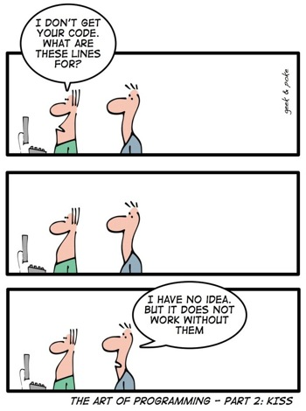
Other Tricky "features" in MATLAB
Notes:
There are some tricky and non-obvious features in MATLAB.

Slide 28
Irritating Front-end "Features"
keyword end not always required at the end of a function (often missing in files with only one function).
command syntax
length('x') or length x
cd('mydirname') or cd mydirname
arrays can be defined with or without commas:
[10, 20, 30] or [10 20 30]
sometimes newlines have meaning:
a = [ 10 20 30
40 50 60 ]; // defines a 2x3 matrix
a = [ 10 20 30 40 50 60]; // defines a 1x6 matrix
a = [ 10 20 30;
40 50 60 ]; // defines a 2x3 matrix
a = [ 10 20 30; 40 50 60]; // defines a 2x3 matrix
Notes:
There are quite a few irritating issues with the MATLAB syntax that are hard to handle with standard parsing tools.

Slide 29
“Evil” Dynamic Features
not all input arguments required
do not need to use all output arguments
eval, evalin, assignin
cd, addpath
load
Notes:
There are also several potentially evil dynamic features.
First, when a function is called, not all arguments need to be provided. In the body of the function one can check to see how many arguments were provided, and then assign a default value to the missing ones (as in line 2 of ProdSumNargs).
Similarly a call to a function need not capture all of the output arguments.
There are several kinds of eval, including the ordinary one, evalin – which is used to eval an expression is a different context (such as the calling functions context) and assignin which is used to assign to a variable in the calling context.
Cd and addpath can be used to dynamically change the current directory or modify the path, which causes a change in function lookup.
Load can be used to load stored variables from a file, and so may cause new variables to be created in the current workspace.

Slide 30
Evil Feature of the Day - Looking up an identifier
Old style general lookup - interpreter
First lookup as a variable.
If a variable not found, then look up as a function.
When function/script first loaded, assign a "kind" to each identifier. VAR – only lookup as a variable, FN – only lookup as a function, ID – use the old style general lookup.
How is the kind assignment done. What impact does it have on the semantics?
MATLAB 7 lookup - JIT
Notes:
There are two styles of looking up an identifier, the old style interpreter based lookup, and a new lookup implemented in MATLAB 7, which has a JIT. This change in lookup has effectively changed the semantics of MATLAB, and so all tools that handle modern MATLAB must implement the new semantics.
In the new semantics, at first load time each identifier is assigned a kind. This is, presumably, to allow for more efficient code generation. The kinds are VAR, FN and ID.
We cannot find any documentation on this, but have written a paper on this topic, submitted to OOPSLA.

Slide 31
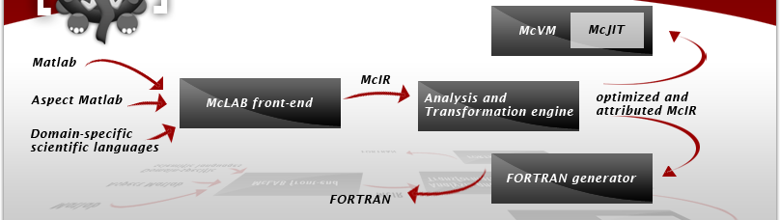
McLab – Overall Structure
Notes:
Talk about front-end and back-ends, then focus on middle part – topic of this talk.

Slide 32
McLab Extensible Front-end
.m source
AspectMatlab
.m source
MATLAB-to-Natlab
Scanner
(MetaLexer)
.m source
Parser
(Beaver)
AspectMatlab
AspectMatlab
AST attributes, rewrites
(JastAdd)
XML
Other
Attributed AST
Notes:
Implemented in Java and Java-based tools.

Slide 33
Analysis Engine
MATLAB
Analyses are written using an Analysis Framework that supports forward and backward flow analysis over McAST and McLAST.
MATLAB-to-Natlab Translator
Natlab
McLab Front-End
McAST Analyses
McAST
McLab Simplifier
McLAST Analyses
McLAST
Notes:
Kind Analysis implemented on McAST, handle analysis implemented on McLAST.

Slide 34
Back-ends, McVM and McFor
McVM
A specializing virtual machine and JIT
Written in C++
Uses McLab front-end, LLVM JIT toolkit, Boehm gc, ATLAS, BLAS, LAPACK
Test-bed for dynamic techniques
McFor
A MATLAB-to-FORTRAN 90 translator
Written in Java
1st prototype showed excellent performance, but worked on smallish subset.
2nd version under development
could potentially by used to generate code for different back-ends.

Slide 35
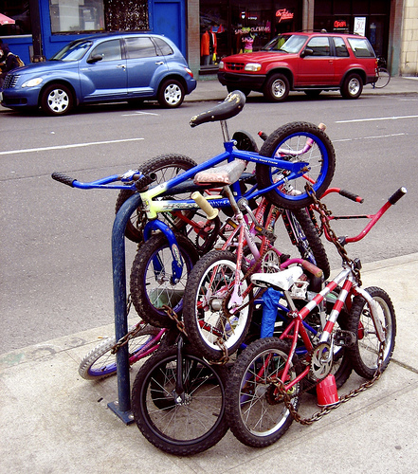
How does MATLAB
resolve
Names?
No official specification
Motivating example

Slide 36
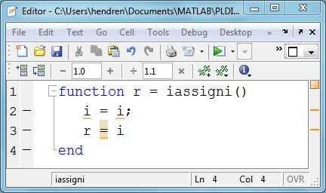
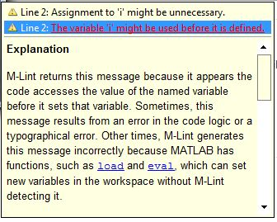

Slide 37
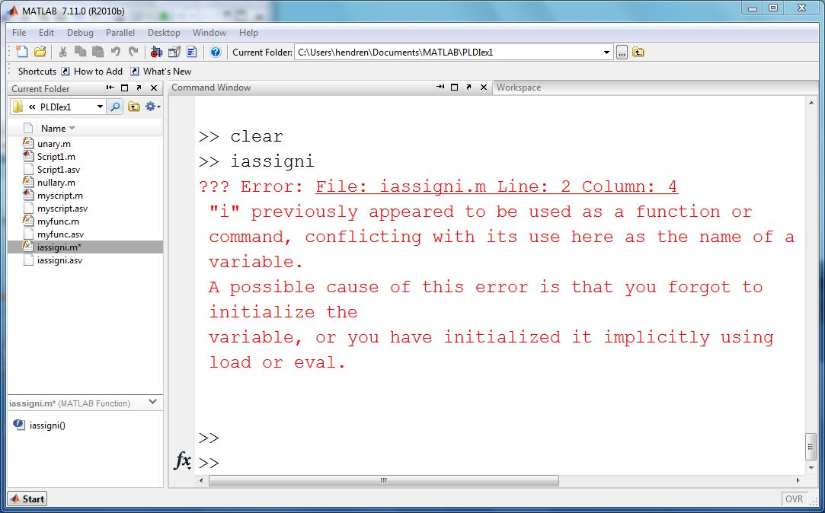

Slide 38
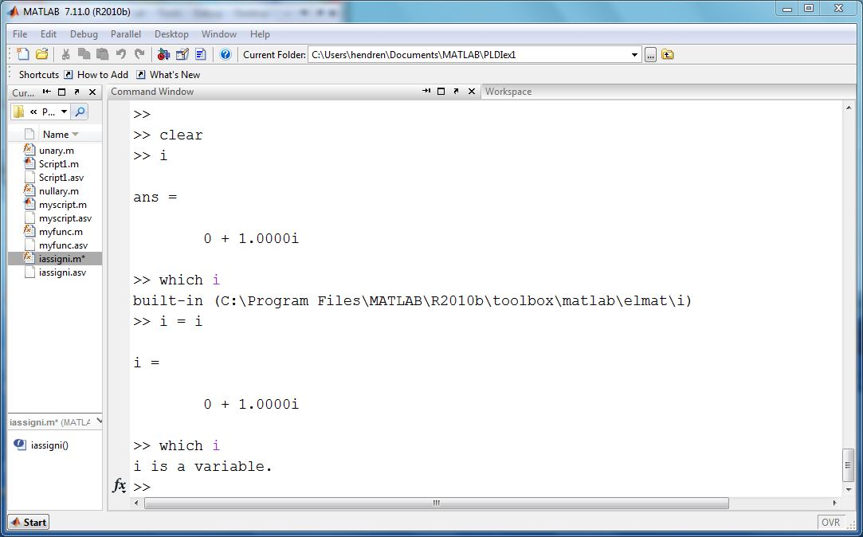
Read-Eval-Print Loop

Slide 39
Evil Feature of the Day - Recap
Old style general lookup - interpreter
First lookup as a variable.
If a variable not found, then look up as a function.
When function/script first loaded, statically assign a "kind" to each identifier. VAR – only lookup as a variable, FN – only lookup as a function, ID – use the old style general lookup.
Compile-time error if, within the body of a function or script, an identifier has kind VAR in one place and FN in another.
MATLAB 7 lookup - JIT
Notes:
There are two styles of looking up an identifier, the old style interpreter based lookup, and a new lookup implemented in MATLAB 7, which has a JIT. This change in lookup has effectively changed the semantics of MATLAB, and so all tools that handle modern MATLAB must implement the new semantics.
In the new semantics, at first load time each identifier is assigned a kind. This is, presumably, to allow for more efficient code generation. The kinds are VAR, FN and ID.
We cannot find any documentation on this, but have written a paper on this topic, submitted to OOPSLA.

Slide 40
Does the kind analysis change the semantics?
New compile-time errors, so programs that would previously execute will not.
Different binding at run-time for some identifiers which are assigned a kind of VAR or FN.
Yes, in two ways!

Slide 41
Compile-time kind error

Slide 42
Different lookup with old vs MATLAB 7 semantics
Old interpreter semantics:
sum, line 2, named function
sum, line 4, local variable
MATLAB 7 semantics gives a static kind of FN to sum
sum, line 2, named function
sum, line 4, named function
Notes:
Let's take a quick look at the kind assignment algorithm. Effectively it must visit all statements in the body of the function and assign a kind. The algorithm implemented by MATHWORKs is neither flow-sensitive nor flow-insensitive, but traversal-sensitive. In this example, "a" and "r" are parameters, so they are variables. "x" and "f" are assigned-to, so they are variables. "sin" has its handle taken, so it is a FN. "i", "j", "sum" are also FN because: (a) they are not VAR, and (b) they can be found when looked in the current fn/file/directory/path. Identifier "s" is not directly definded, nor can it be found upon a function lookup, so its kind is left as ID, and a fully dynamic lookup will be used at runtime. In this case when you run the program, "s" will be found in the workspace.
2nd click: trace of running, note that the statements in the body of KindEx are not terminated by ";", so the results of the statements are echoed at run-time.

Slide 43
Our approach to the Kind Analysis Problem
Identify that a kind analysis is needed to match MATLAB 7 semantics.
Specify and implement a kind assignment algorithm that matches the observed behaviour of MATLAB 7. (both for functions and for scripts)
Identify any weaknesses in the MATLAB 7 approach and suggest two more clearly defined alternatives, one flow-sensitive and one flow-insensitive.
Determine if the alternatives could be used without significant change to the behaviour of existing MATLAB programs.

Slide 44
Kind Abstraction
** error **
FN
VAR
MAYVAR
ID
UNDEF

Slide 45
Kind Analysis
Collect all identifiers used in function/script and set initial kind approximations for each identifier.
Traverse AST applying analysis rules to identifiers.
Traverse AST making final kind assignment.
Steps 1 and 3 are different for scripts and functions, step 2 uses the same rules.

Slide 46
Step 2: Kind Analysis Rules
Definition of identifier x:
Use of identifier x:

Slide 47
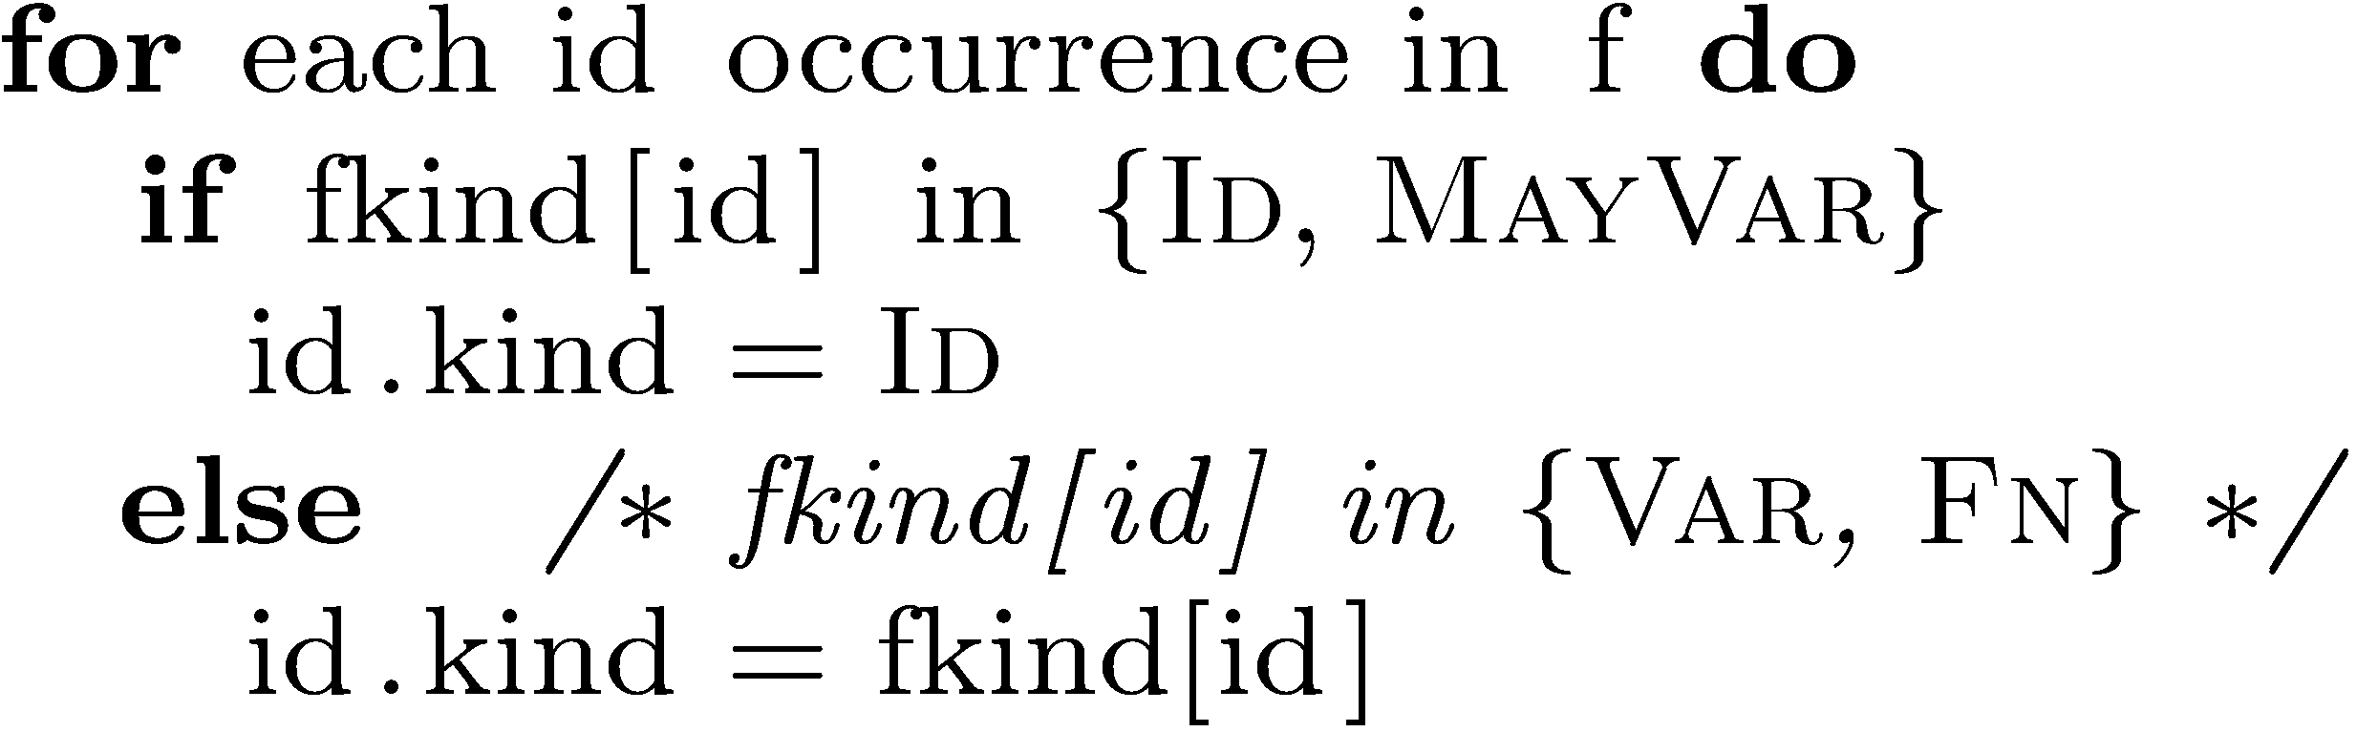
Kind Analysis for Functions
Initial values: input and output parameters are initialized to VAR, all other identifiers are initialized as UNDEF.
Final values:

Slide 48
{(r,VAR),(i,UNDEF)}
{(r,VAR),(i,FN)}
{(r,VAR),(i,**error**)}
READ RULE
WRITE RULE

Slide 49
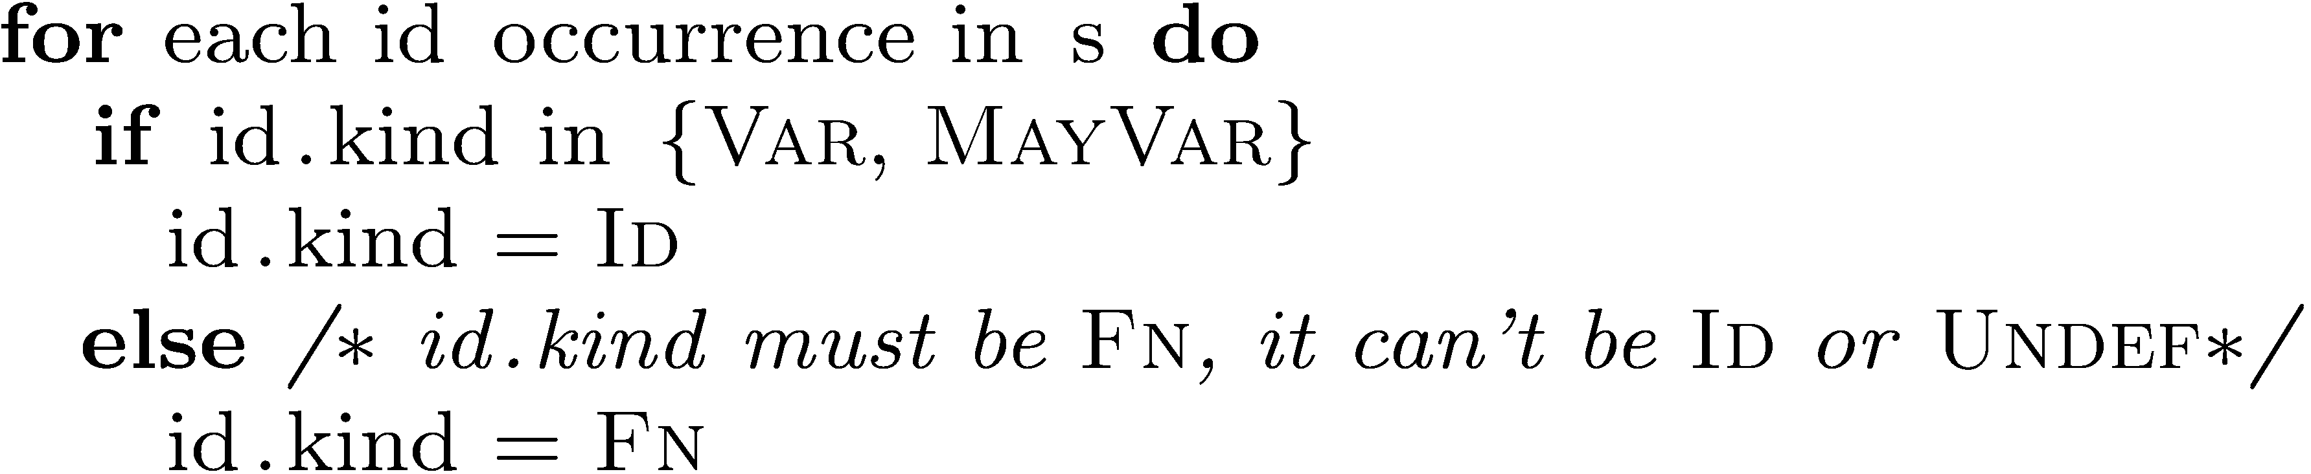
Kind Analysis for Scripts
Initial values: all identifiers are initialized to MAYVAR
Final values:
Note: most identifiers will be mapped to ID

Slide 50
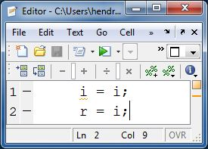
{(r,MAYVAR),(i,MAYVAR)}
{(i,ID)}
{(r,MAYVAR),(i,MAYVAR)}
{(r,MAYVAR),(i,VAR)}
{(r,ID),(i,ID)}
{(r,VAR),(i,VAR)}
READ RULE
WRITE RULE

Slide 51
Problems with MATLAB 7 kind analysis
apparently not clearly documented, in some ways just a side-effect of a JIT implementation decision
without a clear specification, confusing for the programmer and compiler/tool developer
loses almost all information about variables in scripts
some strange anomalies due to a "traversal-sensitive" analysis

Slide 52
Examples of Anomalies
if ( exp ) ... = sum(10); (sum,FN) else sum(10) = ...; *error* | if ( ~exp ) sum(10) = ... ; (sum,VAR) else ... = sum(10); (sum,VAR)
size(size(10)) = ... (size,VAR) (size, VAR) | t = size(10); (size,FN) size(t) = ... *error*

Slide 53
Flow-sensitive Analysis
if ( exp ) ... = sum(10); (sum,FN) else sum(10) = ...; (sum, VAR) // merge, *error* | size(size(10)) = (size,FN) *error*
Apply a flow-sensitive analysis that merges at control-flow points.
Consider explicit loads to be definitions -
load (’f.mat’, ’x’)
Map final kinds for scripts using the same algorithm as for functions.

Slide 54
Flow-insensitive Analysis
if ( exp ) ... = sum(10); else sum(10) = ...; (sum,VAR) | size(size(10)) = (size,VAR)
Assign VAR to identifiers that are defined on lhs, or declared global or persistent.
Assign FN to identifiers which have a handle taken or used in command syntax.
Assign FN to identifiers that have no assignment yet, and which are found in the library.
*error* if assigned both FN and VAR

Slide 55

Results:
What is the distribution of kinds for functions/scripts in real MATLAB programs?

Slide 56
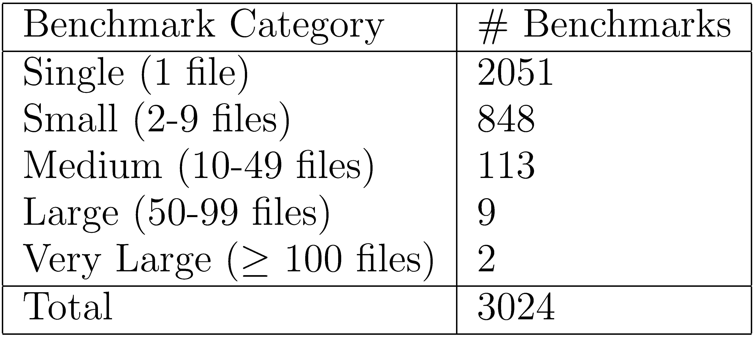
Various-sized benchmarks from a wide variety of application areas
Send benchmarks or links to hendren@cs.mcgill.ca

Slide 57
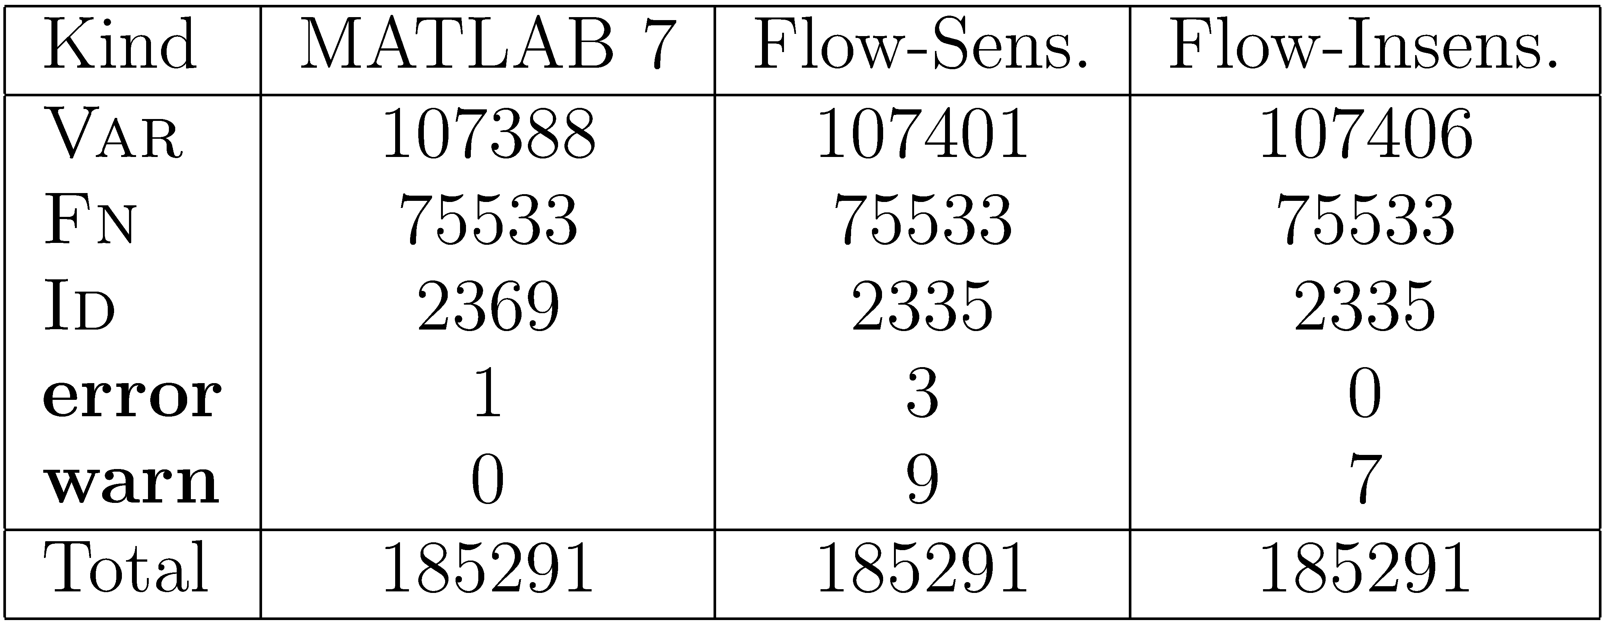
Results for Functions - number of identifiers with each Kind
11698 functions

Slide 58
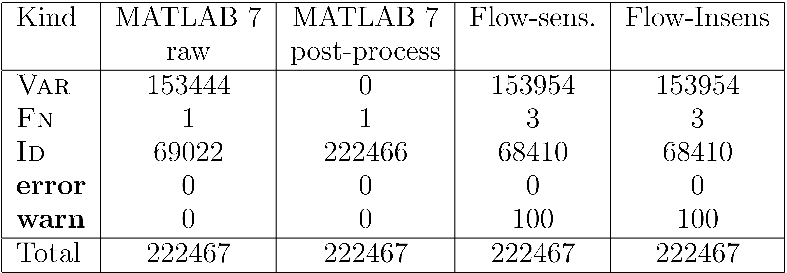
Results for Scripts – number of identifier instances with each Kind
2035 scripts

Slide 59
Conclusions and Ongoing Work
McLab is a toolkit to enable PL, compiler and SE research on MATLAB (close the gap).
Release of three main tools: front-end/analysis framework, McVM (Virtual Machine) and McFor (MATLAB to FORTRAN) (tbd). PLDI 2011 tutorial.
High-level: Refactoring tools for MATLAB. How to help programmers convert their programs to better structured, and more efficient codes?
Lower-level: static compilation to Fortran90 and new dynamic techniques in McVM/McJIT.
http://www.sable.mcgill.ca/mclab

